Slide 1
2024 Hickory Farms Community Association Annual Meeting
October 15, 2024

Slide 2
Looking to the Future - Enhancing our community and ensuring it remains a wonderful place to live
Volunteer Programs
Welcome Wagon
Block Captain
Be Well Team
Community Engagement
Social Events
Encourage Interaction
Infrastructure Improvements
Common Areas
Entrance Signs
We encourage everyone to get involved and contribute to continue making our community a great place!
Vice President: Telah Jackson

Slide 3
Budget
INCOME
Assessments | $57,420
Assessments - Late Fees
Interest | $1,400
Advertising | $100
Legal Fees Recovered
VPOAA Disclosure Fees | $850
TOTAL INCOME | $59,770
EXPENSES
Common Area Maintenance | $28,700
Common Area Improvement | $3,500
Common Area Remediation | $6,300
Insurance - Director's Liability & Surety | $1,000
Insurance - General Liability | $400
Legal Fees | $2,500
Postage | $300
Neighborhood Watch | $300
Printing | $500
Social Activities | $2,000
Tax Preparation | $400
Taxes & Government Charges/Fees | $300
Capital Reserve Deposits | $9,470
Administrative Fees | $1,900
Strategic Projects | $2,000
Bank Charges | $200
TOTAL EXPENSES | $59,770
INCOME LESS EXPENSES | $0
Notes: Reserve Fund $77,372 as of 07/31/2024 (Money Market and CD Account)
Budget Highlights
Reserve Fund: ~ $77,000
2025 HOA Annual Dues: $290
HOA Annual Fee Due Date: February 1, 2025
Expenses:
Common Area
Social Activities
Insurance
Legal Fees
Administrative Fees
Strategic Projects
Treasurer: Judy Deng

Slide 4
Communication: What We are Doing Now and What's to come
2024
Hickory Farms Website
Listserv
Little Free Libraries
2025 +
Hickory Farms Website
Listserv
Little Free Libraries
Homeowner & Tenant Distribution Groups
Block Captains
Select Printed Newsletters
Select Printed Newsletters

Slide 5
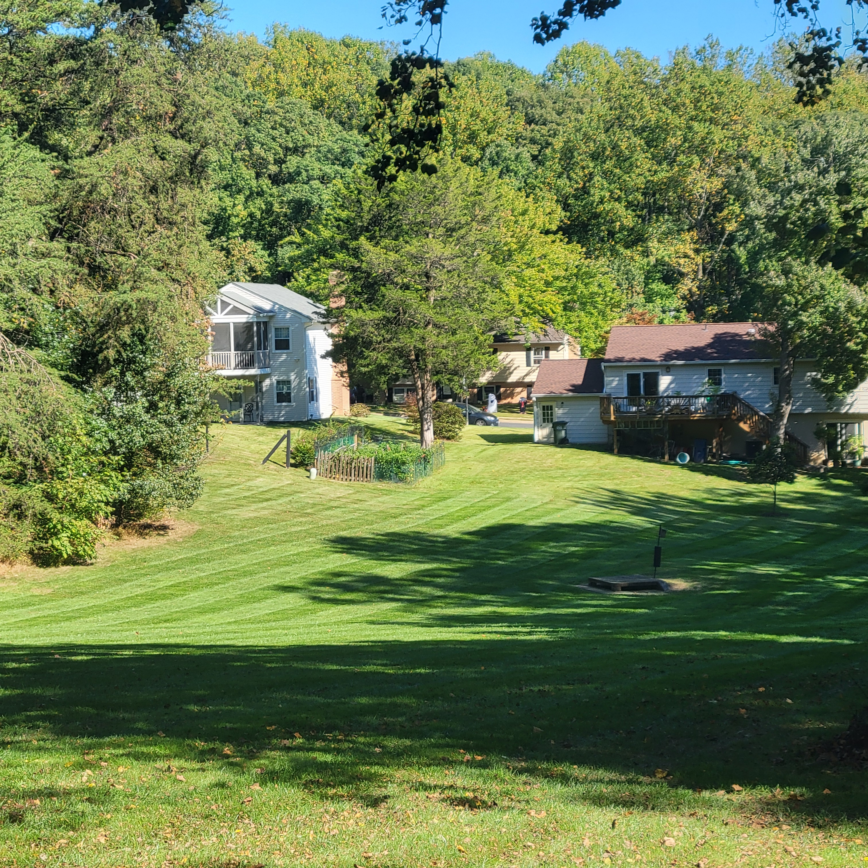
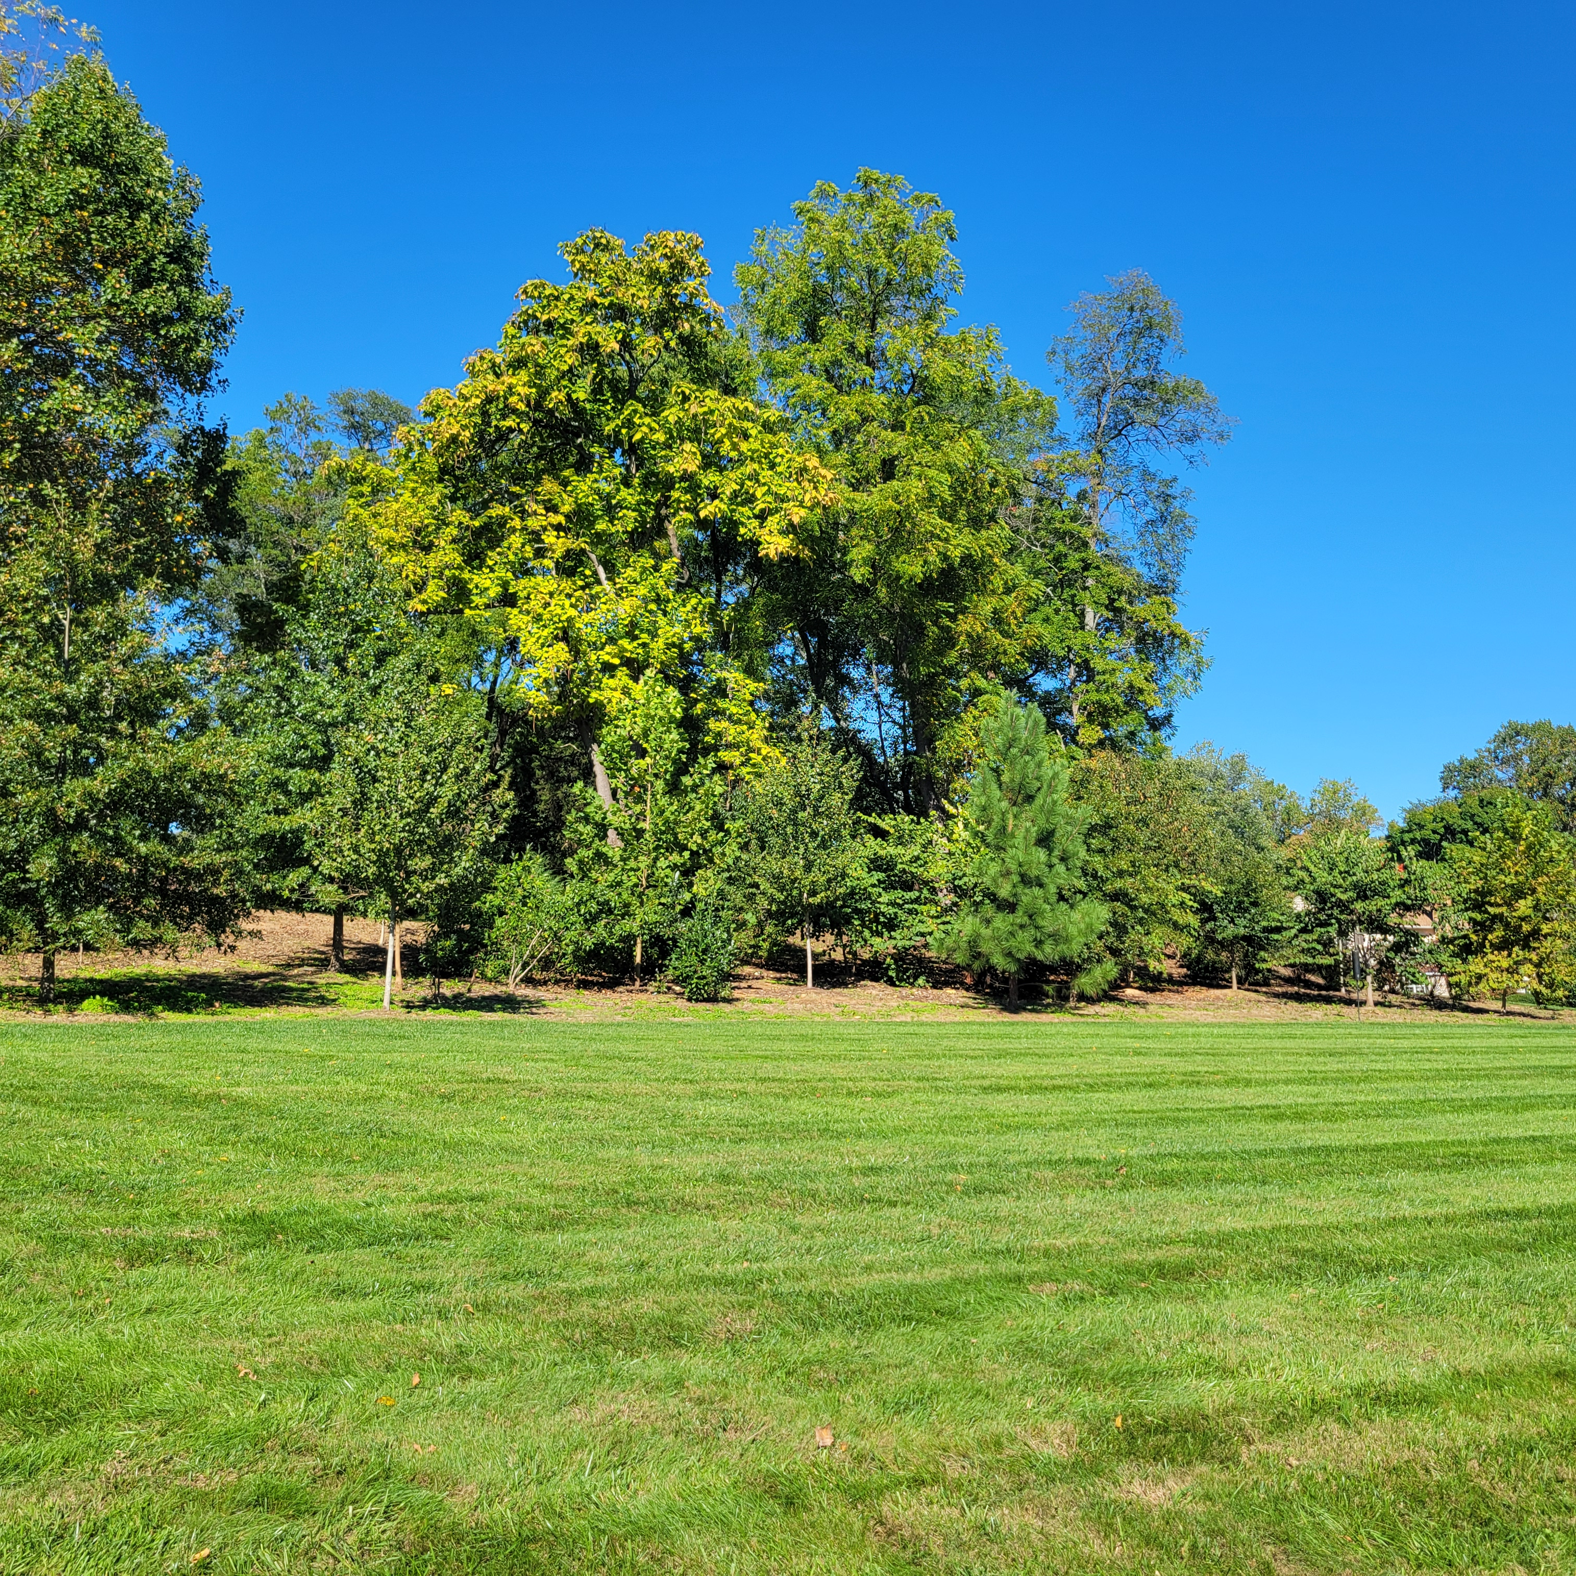
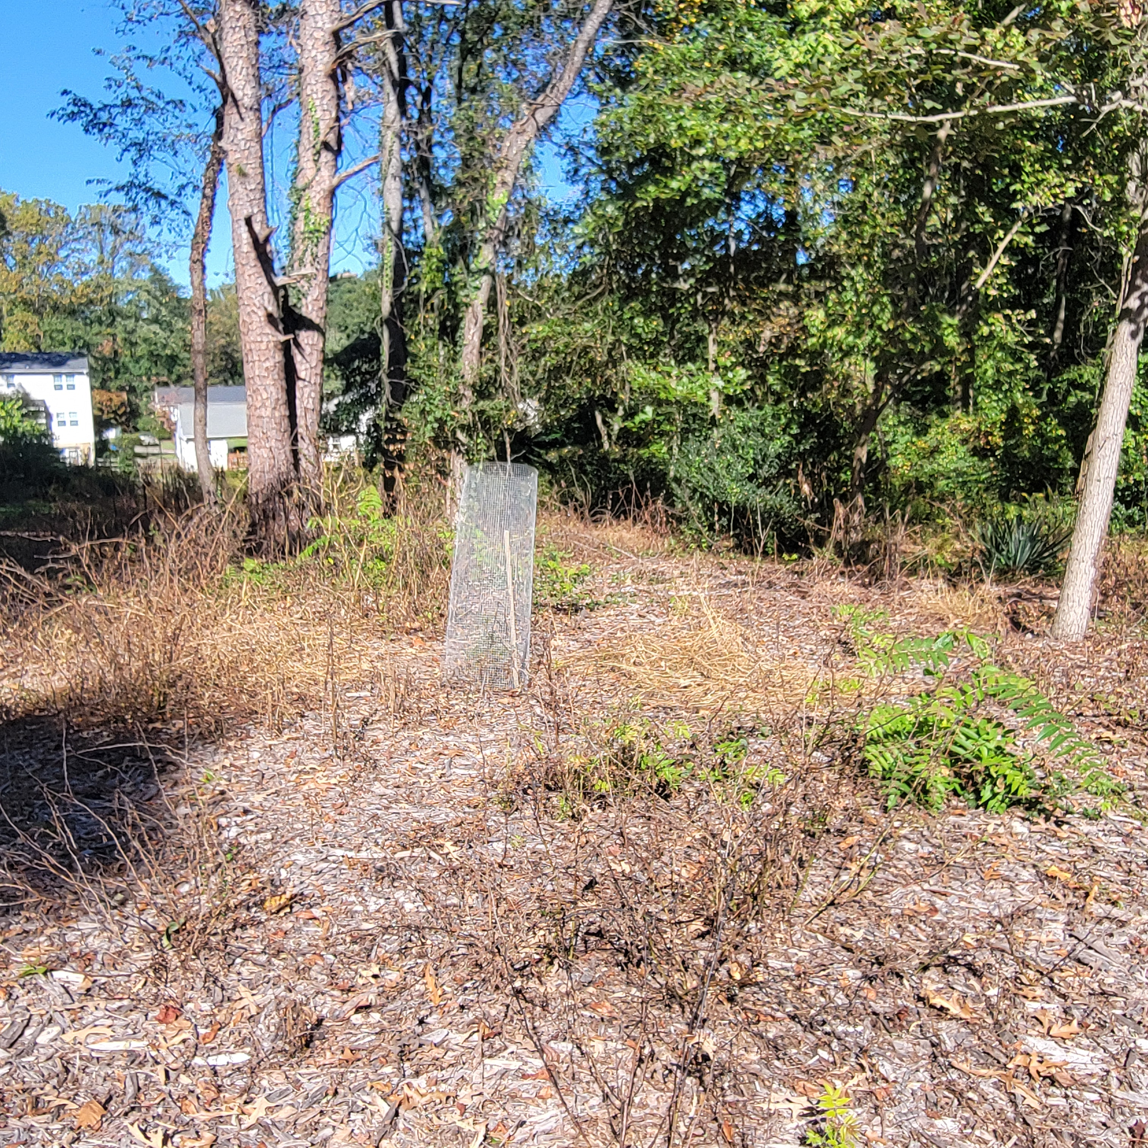
Common Areas Maintenance

Slide 6
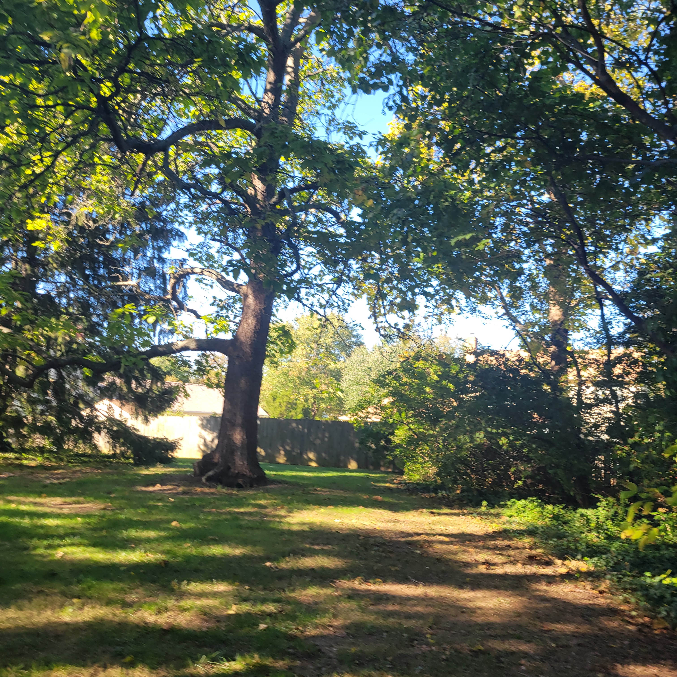
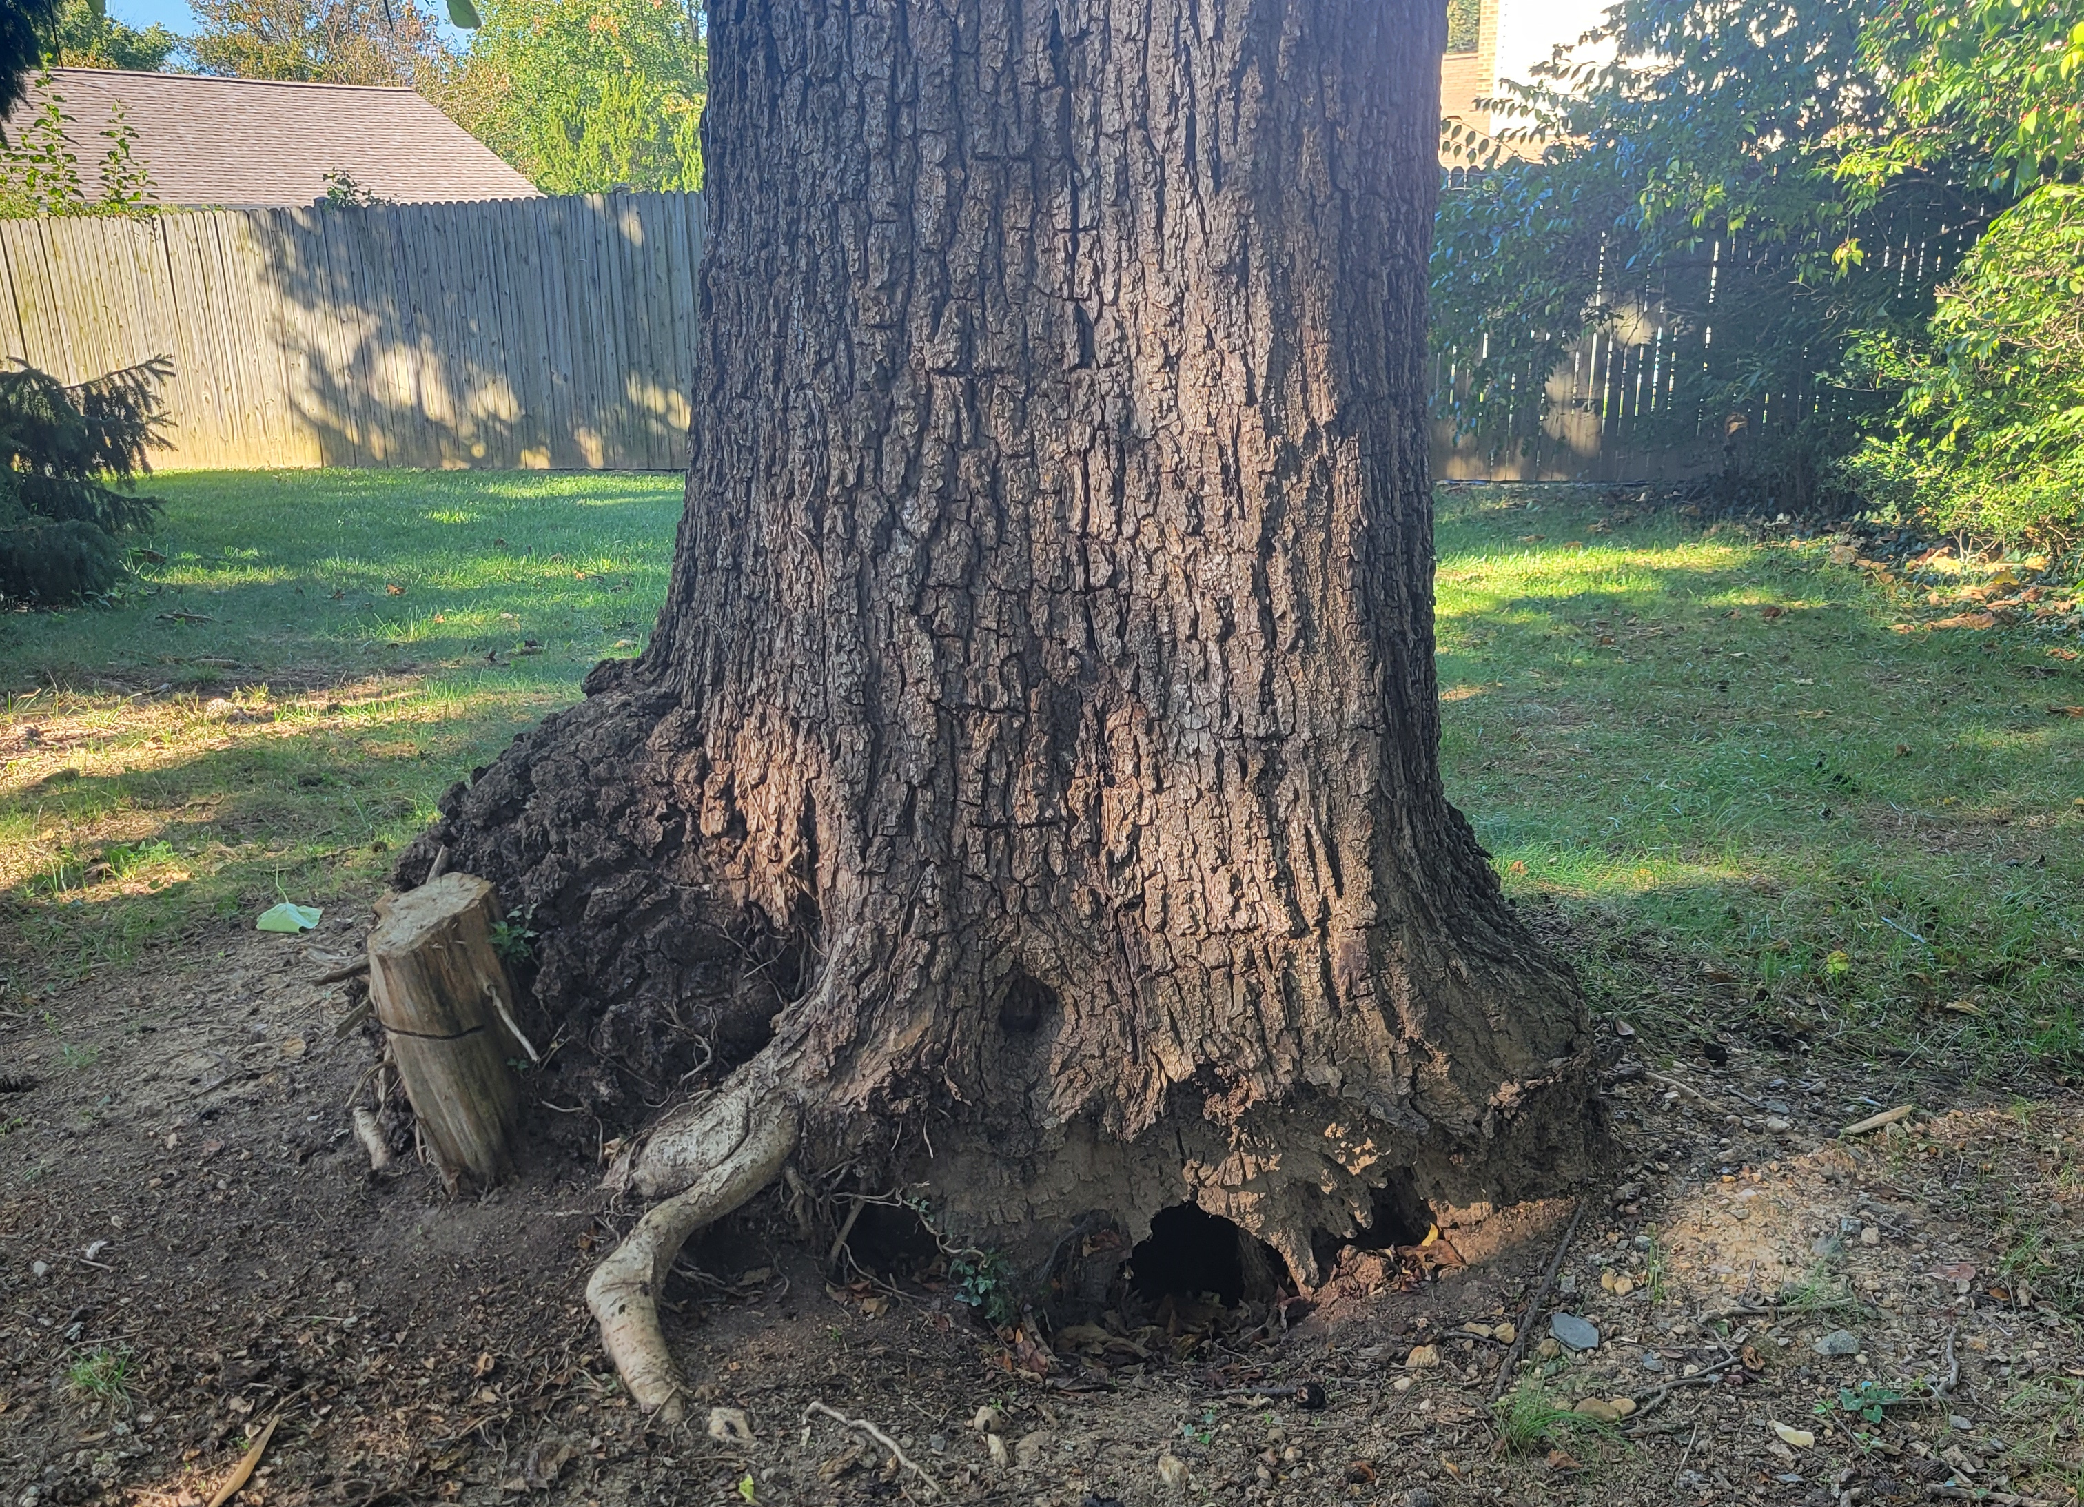
Common Areas Remediation
2024 Tree Work Cost = $14,000
This work consumed the remediation budget, improvements budget and a portion of the maintenance budget.
Tree Work To Be Completed:
October 21st Upper Commons &
October 22nd Lower Commons & along Rabbit Run
Commons Area Coordinator: Melissa Stark

Slide 7
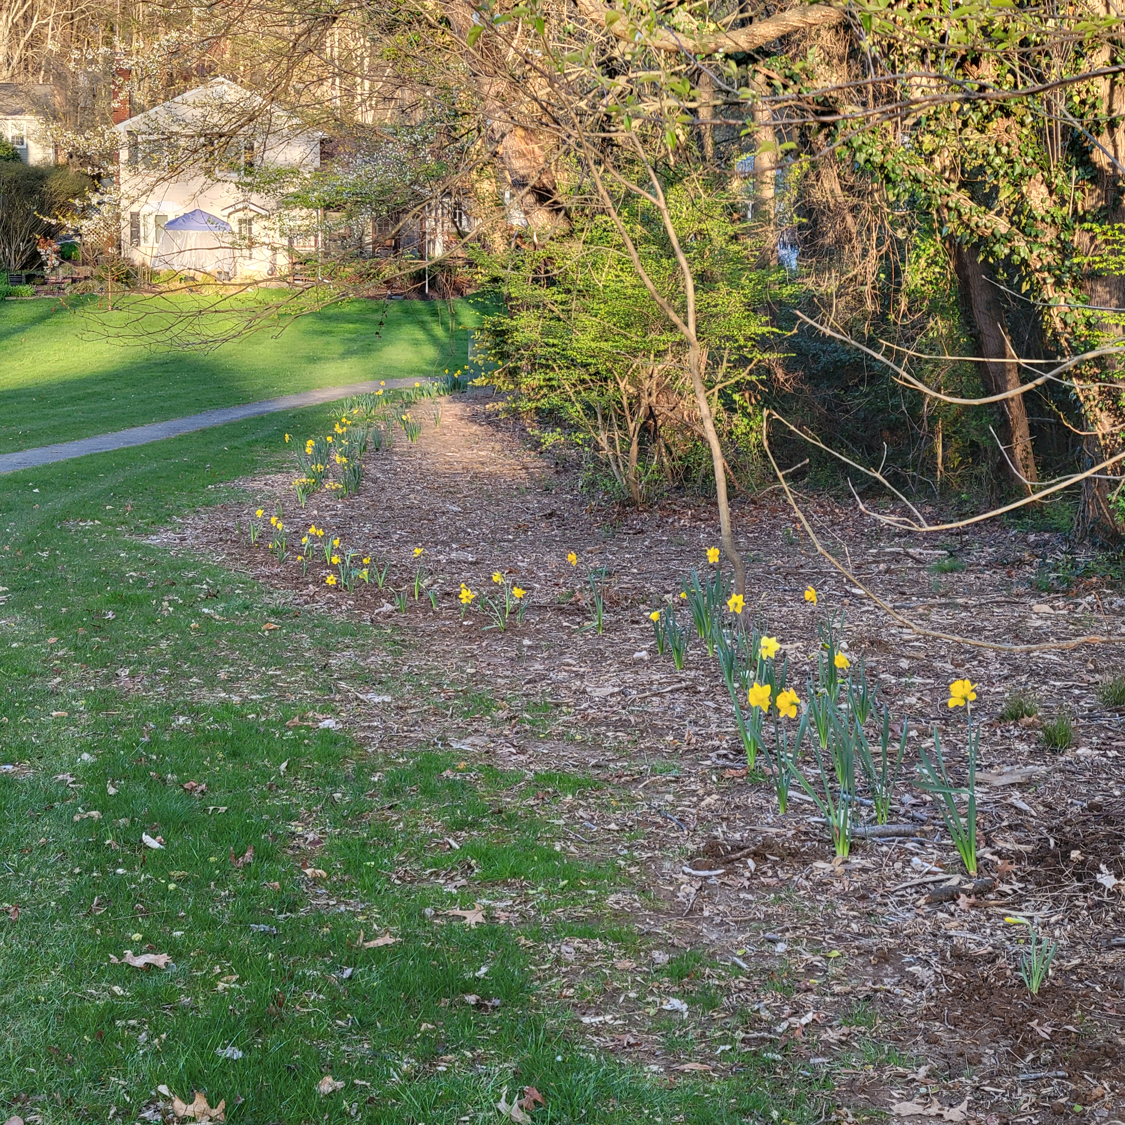
Common Areas Improvements
200 Daffodils planted in the Lower Commons
6 trees planted
20 native ground cover species

Slide 8
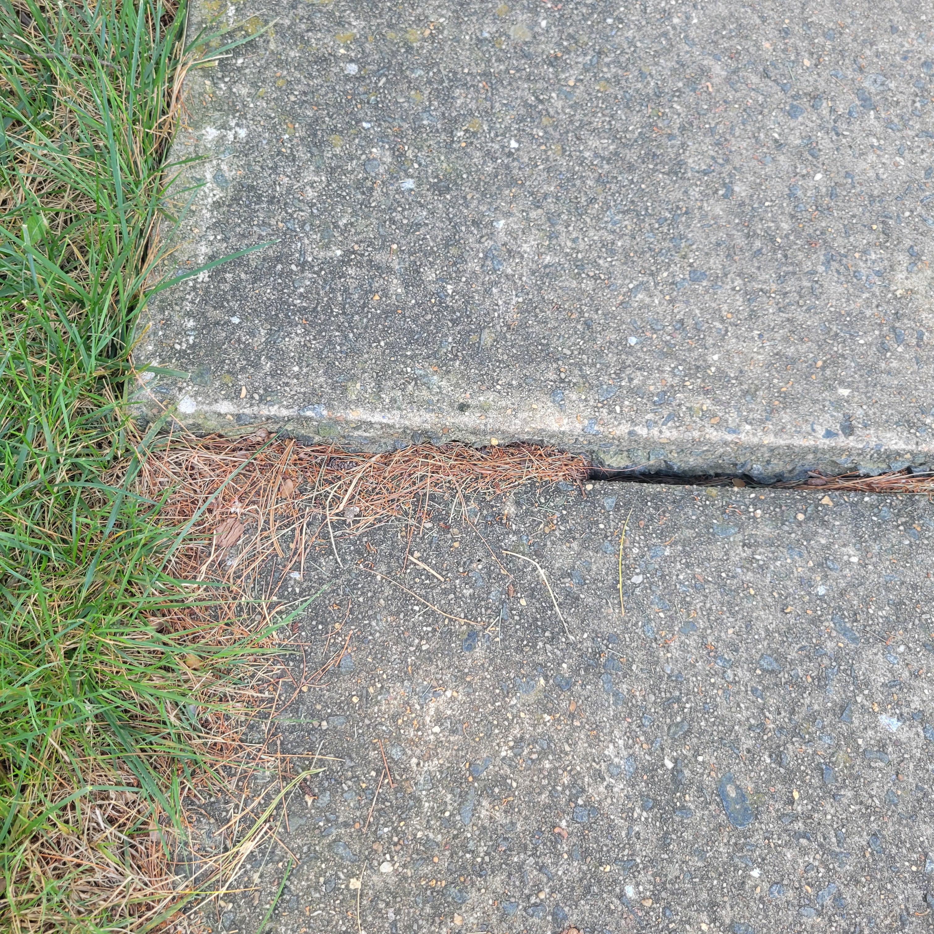
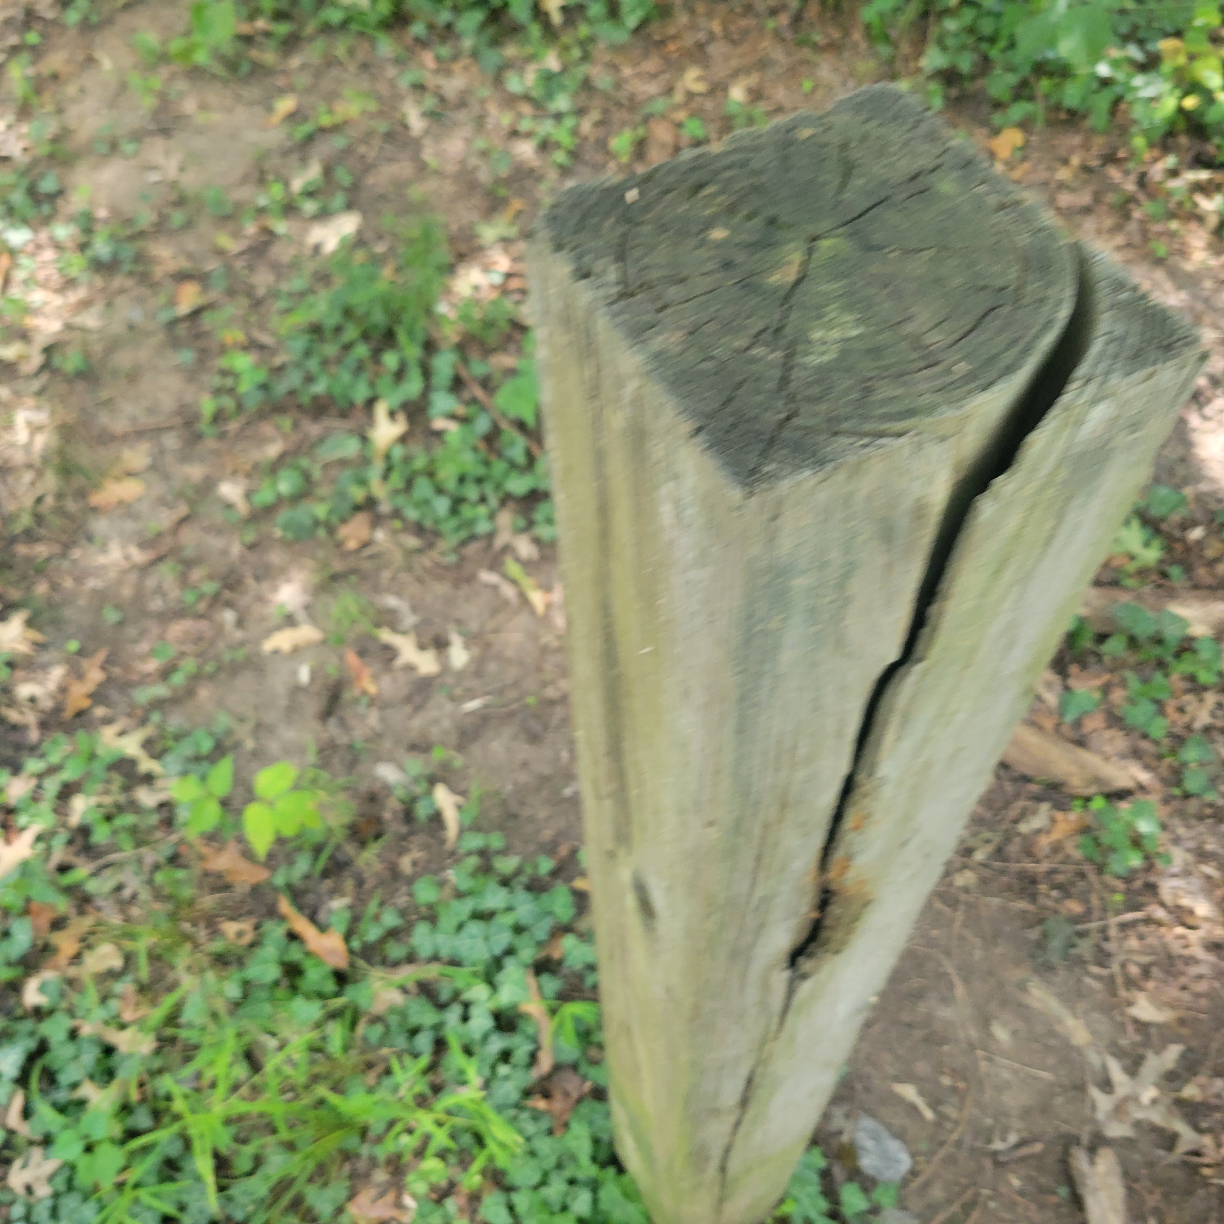
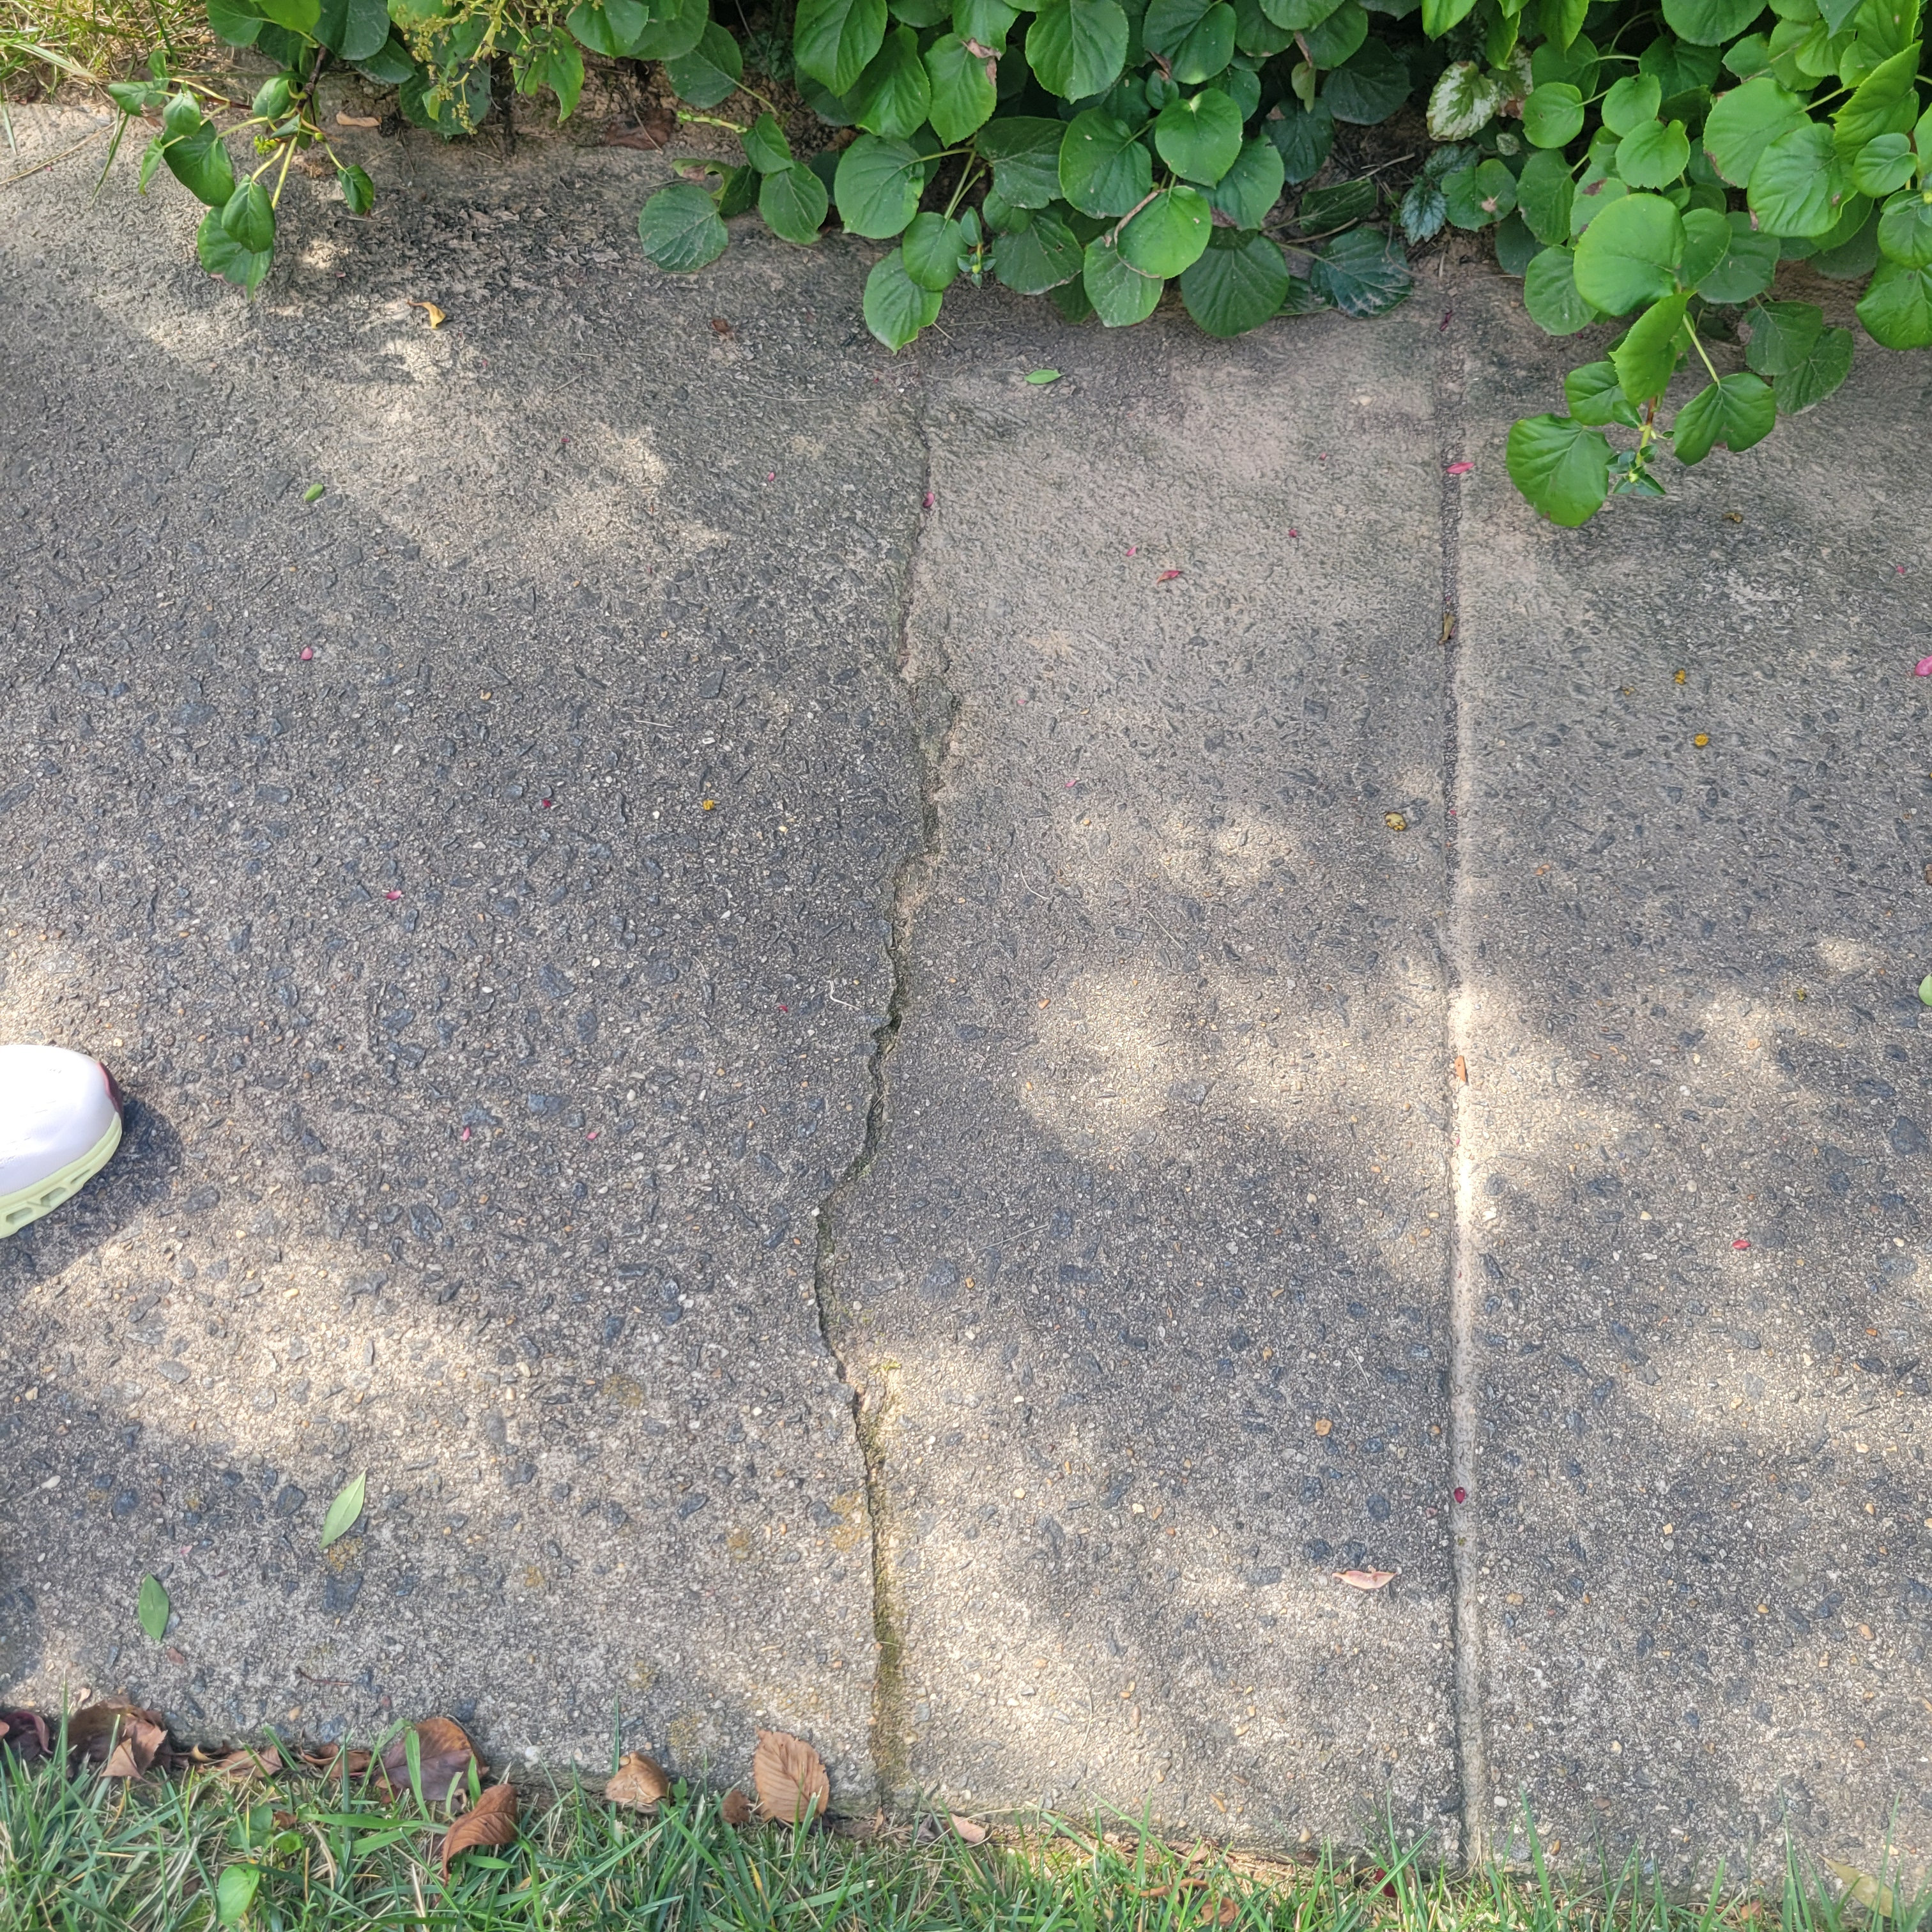
Reserve Study
A reserve study includes:
An assessment of the HOA's financial standing
An inspection of the HOA's common areas
A list of the HOA's components
An estimate of the remaining useful life of each component
A projected expenditure for each component
A repair and replacement schedule
A funding plan

Slide 9
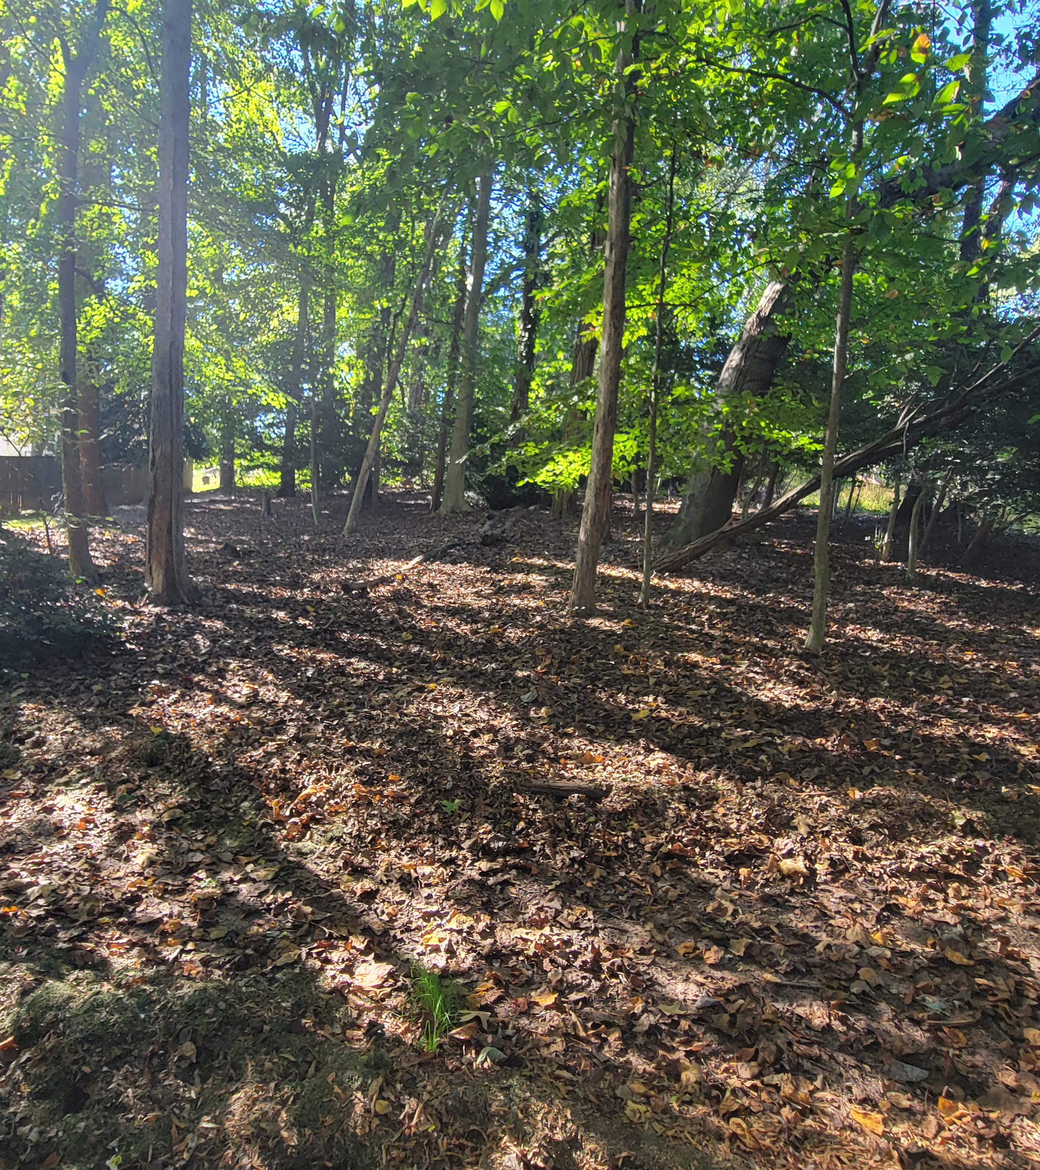
Top Volunteer Award Goes to.......
Rob Smelik
Rob Smelik – Farm House

Slide 10
Bluebird Trail & Purple Martin Colony 2024
Bluebird Trail
Eastern Bluebird: 28 (3rd-highest all-time)
Tree Swallow: 4 (first successful nesting since 2015)
House Wren: 7 (average)
Skylights seemed to deter House Sparrow predation: we will retro-fit four more boxes with skylights for 2025
Purple Martin Colony
4 breeding pairs (to avoid disturbing birds, we did not lower the colony to count hatchlings)
It can take several years for a colony to be completely filled with nesting birds (our colony has 18 boxes)

Slide 11
Bluebird Trail By the Numbers
Yearly Average
EABL | 18
TRES | 3
HOWR | 8
OTHER | 0

Slide 12
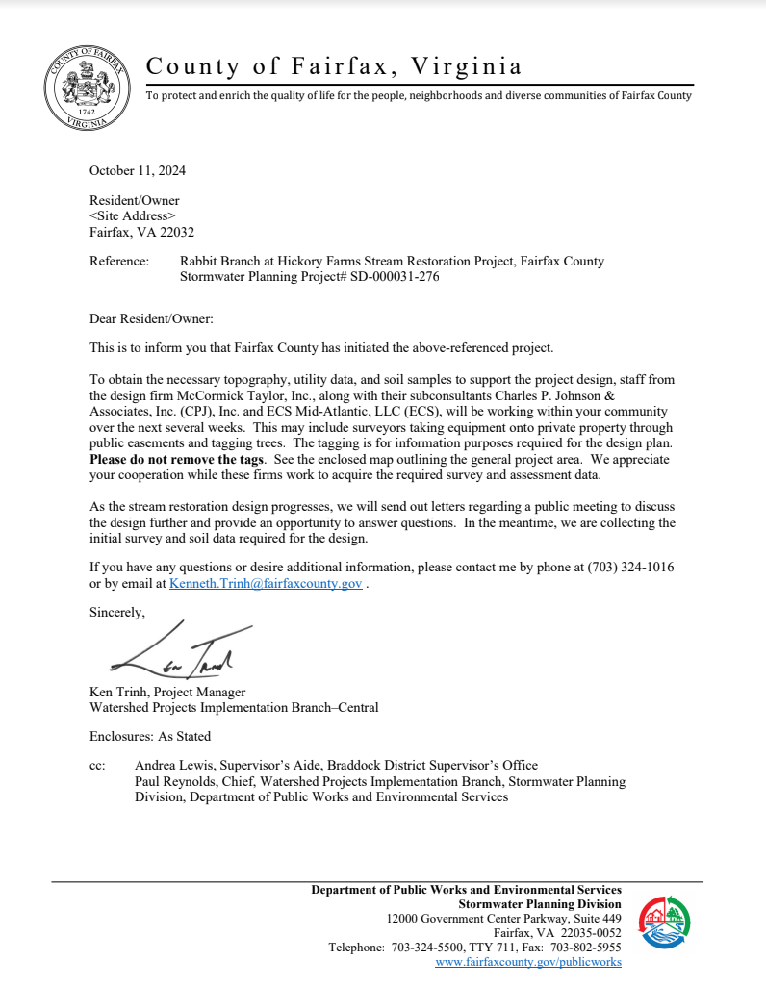
Rabbit Run Remediation Project Update

Slide 13
Rabbit Run Remediation Project Update
~October 2024
Design Phase Approved & starting shortly
~March 2026
Design Phase (18 mo)
~Sept 2026-early 2027
Construction Phase will follow (estimate 6-12 months)
Survey RPA
Obtaining easement from HF residents and adjacent property owners
Community Outreach by Rabbit Run Committee

Slide 14
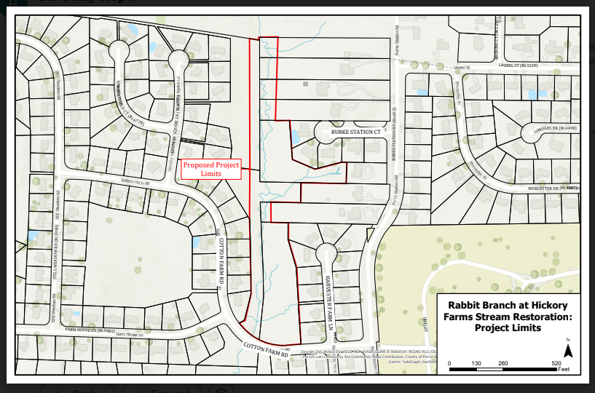
Rabbit Run Remediation Project Map

Slide 15
Rabbit Run Remediation Project Story Map
There will be a website and “story map” for our project.
Here are links to current projects to show the type of information that will be available to HF residents as the project progresses:
Difficult Run Tributaries and Basins Restoration at Government Center
https://www.fairfaxcounty.gov/publicworks/node/734?auHash=rVaSsPaV7PrBD9f70
RmFbHIa4EVzlD6vJkJxgpWXjdM
Old Courthouse Spring Branch at Ashgrove Historic Park StreaRestoration
https://www.fairfaxcounty.gov/publicworks/stormwater/plans-projects/old-courtho
use-spring-branch-ashgrove-historic-park-stream-restoration
Click on “Story Map” to see additional details

Slide 16
Amendment to the Hickory Farms By-Laws
Article VII Powers and Duties of the Board of Directors, Section 1(f), is hereby added as follows:
Impose penalties that may be established by resolution of the Board of Directors, including but not limited to imposition of violation charges, for failure by a Lot Owner to comply with any of the terms of the Association's Declaration, Bylaws, and the rules and regulations, Pursuant to the Association's Due Process Procedures, a Lot Owner will be given the opportunity to be heard and represented by counsel before the Board of Directors, prior to imposing any penalties.
Vice President: Telah Jackson

Slide 17
Upcoming Social Events
Spring Egg Hunt
Apr. 6th, 2025 from 2 – 3 PM
Location: Lower Common
Snacks provided
Summer kick-off
May 31st, 2025 from 3 – 5 PM
Kona Ice, bounce house
Neighborhood Turns 50 Celebration
Saturday, October 18th, 2025 (TBD)
Fall festival
Oct. 26th, 2024 from 3-5 PM
Location: Upper Commons
Cupcakes, Cookies, bounce house, crafts, photo booth
Halloween 2024
Porch lights on if you are a participating in handing out candy
Winter Holidays
Dec 21st, 2024 from 6:30-8:30 PM
Holiday lights walk, Hot cocoa truck, voting for holiday lights

Slide 18
ACC
Home Inspections:
All homes inspected either in person with owners if requested or on 17 and 18 August walk through
After ACC coordination on the results 20 letters were sent via certified mail 7 October.
10 – Fences In Accordance With Rules & Regulations 1.3
8 – Maintenance IAW R&R 1.4
4 – Yard & Plants IAW R&R 1.4
ACC Lead: Justin Mensen

Slide 19
ACC Continued
Approved Applications:
4371 Harvester Farm – New Shed
4360 Harvester Farm – Garden Beds
4352 Harvester Farm – Fence
10020 Cotton Farm – French drains & retaining wall
4301 Still Meadow – Paint color change
4317 Farm House – Door change
10021 Cotton Farm – Shed
4285 Country Squire – Driveway
Properties along Roberts Road – Blanket 8-foot fence approval
10117 Round Top Court – New windows, door, and siding
10005 Cotton Farm – New Door
4357 Farm House – New windows, rain gutters, & fence
4377 Still Meadow – Whole house generator
4336 Still Meadow – Replace shingles
4324 Farm House – Replace siding
4315 Still Meadow – New door
4279 Country Squire - Fence
ACC Lead: Justin Mensen

Slide 20
Hickory Farms 50th Anniversary Oct. 20, 2025
Help us commemorate our historic milestone
Join Our 50 -year Celebration Committee
HFCA Party Planners and Historians needed!
Resources and Documents
Historically our newsletter has been how we:
talk to our community;
protect and celebrate our community;
and remember our community.
In 2025 six part chronicle of HFCA.
^{Historian: Pam Barrett}

Slide 21
Hickory Farms Open Positions & 2025 Board Affirmation
President
Secretary
Reserve Study Lead
Affirm the 2025 BOD:
Pam Barrett
Charles Chu
Judy Deng
Telah Jackson
Ben Noviello
Melissa Stark
Tad Weed
Positions in Need:

